Slide 1
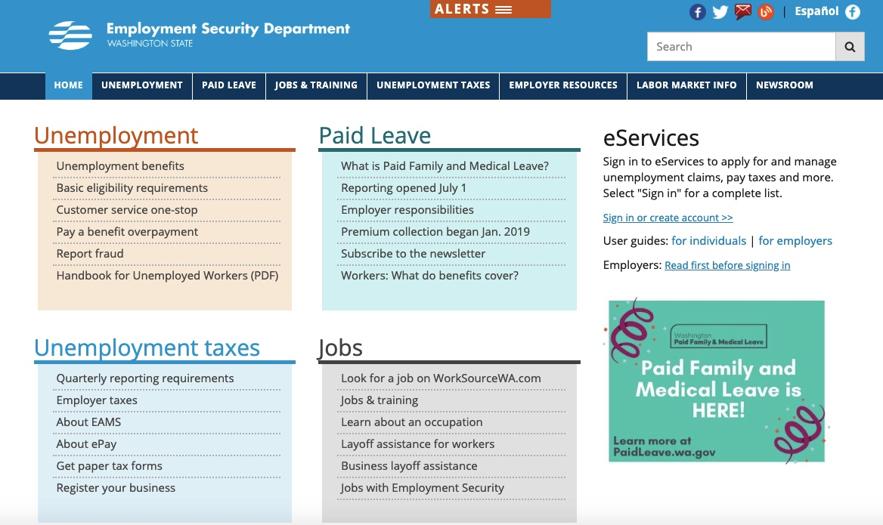
Attention/ Perception Applied Analysis Assignment #1
Alyssa Hagen
January 18, 2020
CommLead 517: The Psychology of UX

Slide 2
Respecting the “gray area” of filing for unemployment on the Washington state Unemployment Security Department website
Thousands of employees annually are laid off or lose their jobs in Washington state and rely on “unemployment” pay, offered through the Unemployment Security Department https://secure.esd.wa.gov/.
Not every unemployment situation is straightforward, thus users, or “claimant” questions that fall into grey areas should be addressed before problems arise.
Currently, when claimants need to contact customer service, they may be “on hold” for over an hour. They may opt to request an email reply or a “call back” within a specific window of time.
Due to the byzantine nature of the site and the lack of availability of customer service personnel, mistakes are made when claimants file for unemployment, causing a cascading effect of problems, compounding ”assessments” and associated fees.
As this site is funded by and used by taxpayers, it is the responsibility of the Unemployment Security Department to make needed changes.
If small changes were made to the site, the user experience would improve and costs for the department and unemployment program would be reduced.
Based on user dissatisfaction:
Additional customer service personnel should be hired.
A partial-pay claim option should be added to the user interface.
Slide 1: THE PSYCH. Describe the psychological process in a way that would be understandable and persuasive to a business decision-maker (original textual summary, 12-14 point font).

Slide 3
If someone works for a few hours each week, the site should have a partial-payout option.
Unemployment claimants are task positive.
Existing question: Did you work this week?
Replace this answer: Yes No
With this: Yes No Partially
Speak to a customer service agent.
Unemployed claimants requesting financial support are task positive. Money is the incentive for the claimant to complete all the steps required to obtain assistance. However, as the claimant experience continues through the duration of their unemployment, gray areas arise.
Example 1: Someone begins a new position today, but they don’t get paid for two weeks.
Are they employed? Yes.
But, do they have an immediate income? No.
Should a yes or no question about whether to file, require a 60-minute phone call? No.
If they are unable to speak with customer service, does it make sense for the newly employed person to claim unemployment that week so they can put food on the table, knowing that they risk the Unemployment Security Department labeling them a “fraud”? Most likely.
Example 2: Someone has been hired with a start date two weeks from today, but is required to attend one hour of paid training tomorrow.
Should they apply for unemployment that week?
Should they be required to repay the one hour of pay, assessed a “fraud penalty” and disqualified for unemployment benefits for six months?
What happens if the person is unemployed again within six months?
Slide 2: THE EXAMPLE. Explain how the psychological process is at play in users' experience with a digital meme (screenshots and half-page explanation).
Notes:
Hi David, I’m locked out of this page on the unemployment site, so I don’t have an actual screenshot. I can add it next week, but hopefully this will suffice for now. -Alyssa

Slide 4
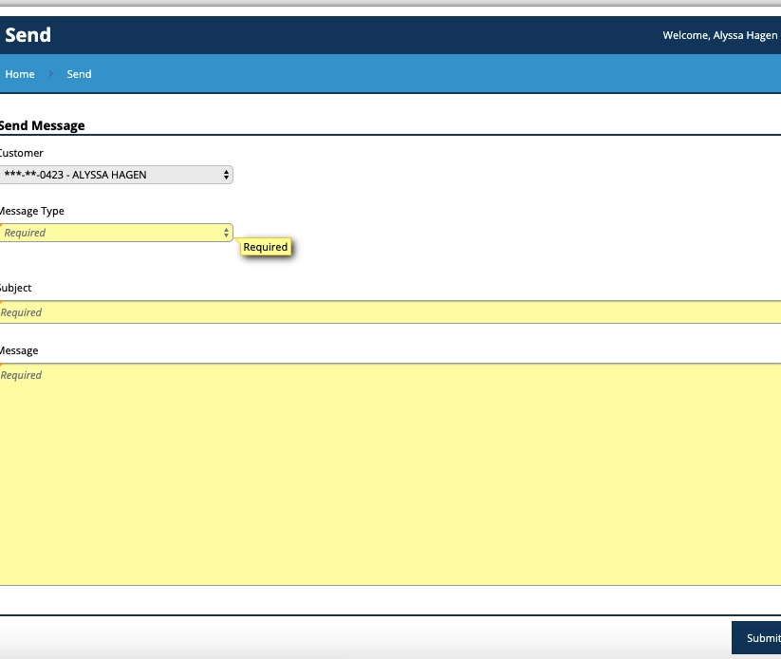
Give users the opportunity to fully comply.
Lacking adequate customer service assistance is a bottleneck; it constrains the users’ access to information and limits progress throughout the steps of filing an unemployment claim.
Like the Unemployment Security Department has a “waiting week” after the last employment paycheck hits, it takes at least a week until the new employment paycheck is deposited.
Because there is no acknowledgement or explanation of this on the Unemployment Security Department site, the user is left to guess whether filing the first week of employment is allowed or not. When the choice comes down to risks such as having gas and paying their mortgage, most people would choose the latter.
99% of unemployment claimants only want to take their share; what is rightfully allotted to them, corresponding with the amount they paid into unemployment while they worked.
When can the message response be expected?
Why is there no Instant Message option?
Slide 3: THE ETHICAL IMPROVEMENT. Recommend for changes to the digital meme would better align it with the psychology of the users (bulleted list and paragraphs).

Slide 5
Failure to address the “gray area” of unemployment will compound user dissatisfaction and increase government spending.
The interface of the Unemployment Security Department website works against the users. By failing to clarify the process, more work is created for everyone by stressing out the claimants, generating hearing dates and billing taxpayers.
Invest more money into instant messaging responses, rather than hearings. Hire more support staff. If you have an auto-message stating that you are “experiencing a high call volume,” or “longer than usual wait times,” you already know you’re understaffed.
When fees are assessed, claimants may begin their next job by owing money to the Unemployment Security Department after claiming an hour or two for required trainings, or the waiting period between being hired and receiving the first paycheck.
While the system may have to see everything in black and white, the users need a grey area to ensure they are in compliance.
Slide 4: AN UNETHICAL IMPROVEMENT. Recommend against changes to the digital meme that would overpower, sidestep, or exploit the psychology of the users

Slide 6
Results directly effect the bottom line and customer satisfaction.
Before and after changes are made to the Unemployment Security Department website, note the following:
Claimant/user satisfaction regarding Unemployment Security Department website.
Amount of flagged, fraudulent filings by claimants that were, in fact fraud.
Amount of flagged, fraudulent filings by claimants that were deemed not fraud.
Number of unemployment claimants served by customer service on a monthly basis. This includes all phone calls, emails and all questions sent through existing platforms.
By using the suggested metrics to determine the success of the site changes, the Unemployment Security Department will also see a subsequent drop in hearings and thus, a reduction in expenses, paid for by taxpayers.
Continual investment in customer service staffing and the ability to obtain feedback before hearings are scheduled, will continue to improve the claimant/customer experience and reduce expenses.
Slide 5: THE RESULT. Identify what business outcome metric (usage, satisfaction) should be measured before and after the changes are implemented.

Slide 7
Readings Memes: 5, 6 Bottlenecks: 2, 4, 5, 6
Deliverable
Five-slide applied analyses in PowerPoint.
Slide 1: THE PSYCH. Describe the psychological process in a way that would be understandable and persuasive to a business decision-maker (original textual summary, 12-14 point font).
Slide 2: THE EXAMPLE. Explain how the psychological process is at play in users' experience with a digital meme (screenshots and half-page explanation).
Slide 3: THE ETHICAL IMPROVEMENT. Recommend for changes to the digital meme would better align it with the psychology of the users (bulleted list and paragraphs).
Slide 4: AN UNETHICAL IMPROVEMENT. Recommend against changes to the digital meme that would overpower, sidestep, or exploit the psychology of the users
Slide 5: THE RESULT. Identify what business outcome metric (usage, satisfaction) should be measured before and after the changes are implemented.

